Slide 1
Real Time data Transfer By Using MQTT and LoRa Protocol
Submitted by,
Mr. Rahul Medidar (BETB44)
Mr. Akash Sanap (BETB76)
Mr. Kuldeep Chavan (BETB31)
Guided By,
Prof. Sandip Nagre

Slide 2
Introduction
Energy management is very important concern In the IOT. LoRa stands for Long Range and low power. It can communicate up to 10 KM in sub-urban areas. It operates on 3.3 V and less than 60 uA current.
Using SPI we can connect multiple nodes to a LoRa master. Using LoRa we are going to send physical parameter to another location where we can control the parameter of the forest, home and remote sensing in the industry

Slide 3
Motivation
Amazon forest bushfire and Australian forest bushfire.
Physical parameter controlling in industry.

Slide 4
Requirement Analysis
Eliciting requirements: LoRa packet receiving survey i.e. we are gone through different research paper and find that the data loss is occurred in receiving node so wanted to avoid it and improve RSSI of signal
Analyzing requirements : From different research paper we are find that the data loss is occurs in receiving side. In sensitive cases the data loss affects dangerous in industry or forest area. Along with data loss latency is occur in received data so we decided to reduce data loss and latency using MQTT and LoRa protocol.
Requirements modeling: As we decided to reduce data loss in LoRa nodes we need to implement the LoRa in different remote area and wanted to calculate BER and RSSI of the signal on the basis of that result we are going to implement the Raspberry Pi gateway in LoRa node and wanted to reduce the data loss and improve speed of received packet.

Slide 5
Aim & Objective
To reduce the data loss at the time of data transferring and increase data transmission.
To improve Receive Signal Strength.

Slide 6
Problem Statement
To reduce data loss in real time data transmission using LoRa and MQTT protocol.

Slide 7
Description Of the Work
Sending data from one node to another node using LoRa protocol.
Implementing multiple nodes using SPI.
Calculating BER of send data.
Implementing Gateway for data transmission.
Implementing MQTT protocol.

Slide 8
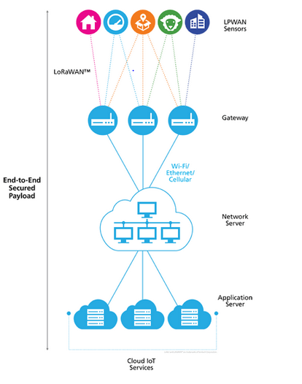
System Overview:

Slide 9
Types of Losses
Propagation through obstacle.
Propagation through Reflection.

Slide 10
Boundaries and Risks
Boundaries :
The obstacles comes in node between Tx nodes Rx node are different hence BER also different.
RSSI of each packet from different nodes are different.

Slide 11
Application
Remote data transferring
Home Automation.
Long range Irrigation system.
Industrial monitoring and control.

Slide 12
References
Susanna Spinsante , Gianluca Ciattaglia, Antonio Del Campo, Davide Perla,Danny Pigini,Giovanni Cancellieri and Ennio Gambi , “A LoRa Enabled Building Automation Architecture Based on MQTT”, Universita’ Politecnica delle Marche Ancona, Italy 60131.
Ao Huang, Mengxing Huang, Zhentang Shao, Xu Zhang, Di Wu and Chunjie Cao, “A Practical Marine Wireless Sensor Network Monitoring System Based on LoRa and MQTT”, 2019 2nd International Conference on Electronics Technology.

Slide 13


